Slide 1
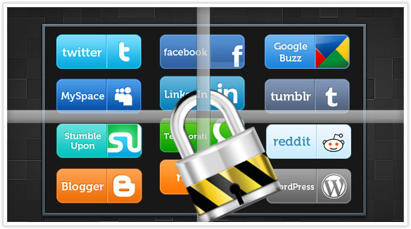
The Negative Effects of Social Media

Slide 3
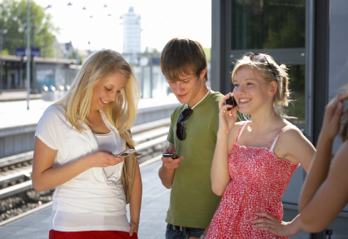
“Social media has changed the way people interact. In many ways, social media has led to positive changes in the way people communicate and share information. However, it has a dark side as well. Social networking can sometimes result in negative outcomes, some with long-term consequences.” (4)

Slide 4
Introduction
In a growing world where technology has become a necessary source of communication, special attention must be placed on the potential hazards of social media.

Slide 5
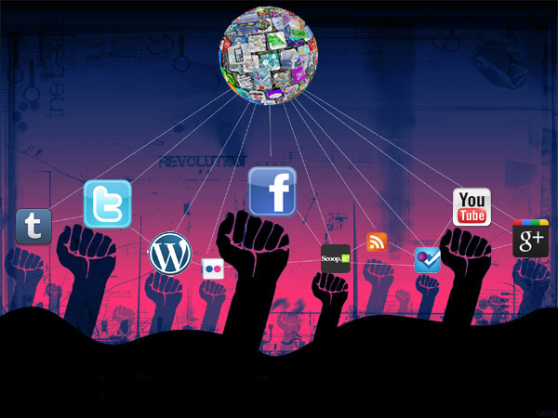
The World of Social Media
http://www.youtube.com/watch?v=ETnLzLnuDco

Slide 6

The Advantages
It’s not difficult to recognize that social media has many advantages. Having the ability to connect with people, staying in touch with friends and family who are far away, and having the freedom to communicate whenever and where ever. All this could be priceless, to a person who may be alone or unable to have outside contact with the world.

Slide 7
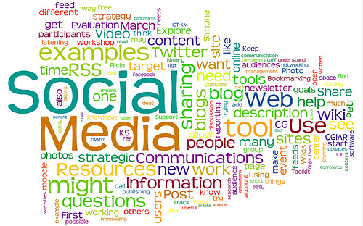
Social Media
Although social media may have many positive advantages, the negative effects of social networking outweigh the positive.

Slide 8
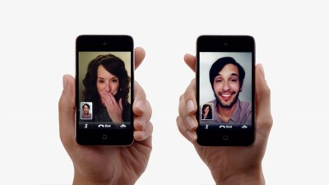
The Impact of Social Media
Vito Pilieci (The National Post Reporter) argued; “In an age when internet devices are always on, meeting face-to-face is becoming increasingly rare as people choose to meet screen-to screen…What is this new dynamic doing to normal social interaction? How do these devices and social media services, such as Facebook, affect the way we socialize and communicate with each other? But, more than that, what impact do these social networks have on their user’s mental health? ” (7)

Slide 9
The Impact of Social Media Cont.
As parents, some of us may be increasingly worried about the negative effects that social media may have on our children.
Others, may not be able to recognize the negative impact of these effects in themselves as it slowly changes their behavior .
Can we prevent the inevitable in a world where social media has become so common?
I wasn’t surprised to learn I’m not the only one with these concerns; but I was shocked to find that there are a lot more negative effects from social media than I initially thought there was.

Slide 10
Negative Effects of Social Media
A false sense of connection
Mental health effects
Encourages poor grammar, usage, and spelling
Exposing children to online predators
Isolation/Loneliness
Broken relationships, infidelity and torn families
Harm to ones reputation
Exposure to cyber bullying
Suicide

Slide 11
Negative effects of Social Media Cont.
Invasion of privacy
Exposure to scams, identity theft, hackers, fraud, and virus attacks
Time consuming
Poor school performance
Increased distraction
Decreased productivity/ Loss of job
Possibility of addiction disorder
Increased risk of obesity
Increased risk of sleep disorders

Slide 12
Negative Effects of Social Media Cont.
Many would argue that some of these negative effects are not a direct cause of social networking, however, social media has created an increased risk for these tendencies.
I will focus on just a few of the negative effects to explain the impact social media has in our lives, sometimes without us even knowing it.

Slide 13

A False Sense of Connection
According to Cornell University's Steven Strogatz, “Social media sites can make it more difficult for us to distinguish between the meaningful relationships we foster in the real world, and the numerous casual relationships formed through social media. By focusing so much of our time and psychic energy on these less meaningful relationships, our most important connections, he fears, will weaken.” (5)

Slide 14
A False Sense of Connection Cont.
We see this false sense of connection a lot more within families and relationships.
One of the biggest enemies in many homes is - time. Complaining that “There’s never enough time”, has become an increasingly common excuse.
So we sit at the table or we go out; rationalizing that “we are spending time together”. However, there is no real connection taking place with each other, when each person is on their own media device.

Slide 15
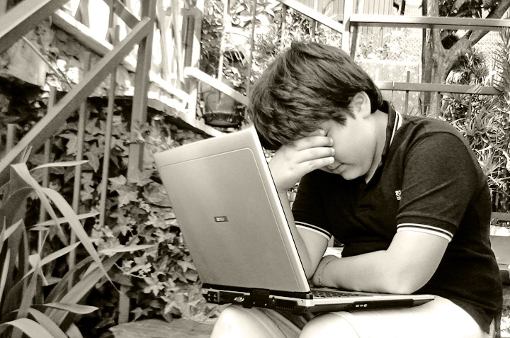

Mental Health Effects
Doctor Larry Rosen over a period of time has studied and researched the mental health effects of social media on individuals. He claims; “Earlier studies reported more negative findings such as young adults with a strong Facebook presence tended towards narcism, antisocial tendencies, and aggression. Overuse was identified as causing anxiety and depression. Excessive use of social media was also linked to poorer achievement at school.” (8)

Slide 16
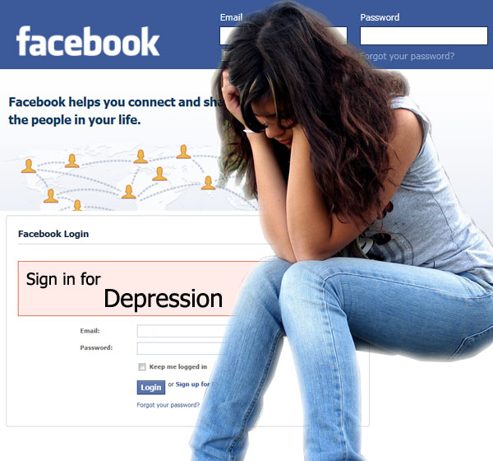
Mental Health Effects Cont.
Social media has become a dangerous pass time for individuals suffering from depression, anxiety, suicidal tendencies, and other mental health issues.

Slide 17
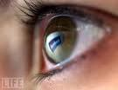
Signs of Unhealthy Social Networking
“While young people are more likely to suffer mental health issues from social networking, anyone of any age may be affected negatively, particularly those adults who are prone to addictive behavior. Everyone should understand the signs of an unhealthy social networking situation and watch for the following signs:

Slide 18
Signs of Unhealthy Social Networking Cont.
Focusing problems – easily distracted and loss of ability to concentrate.
Lack of concern about one-on-one relationships – prioritizing social networking over face to face family and friend relationships.
Lessening communication skills – talking less, difficulty articulating thoughts into words, inattentive when others are speaking.
Unconcerned about obligations in the “real” world – more interested in checking status updates and communicating on the internet than participating in activities off of the computer.
Withdrawal symptoms (agitation, fidgeting, aggressiveness, etc) when unable to participate in social networking for a period of time.” (1)

Slide 19
Awareness
Being a part of the social media revolution requires personal education and responsibility of the hazards.
Parents should become familiar with the warning signs of the negative impacts to their children.

Slide 20
Social Media and Its Effects on Suicide
“The study for the National Center for Telehealth and Technology (a health organization that typically works with the military on brain injuries) was completed in response to the rising number of suicide deaths because of cyberbullying. It found that, while it’s a difficult subject to study (“only” one million people worldwide commit suicide), there are several consequences when it comes to Internet use and increased suicide rates:
- Cyberbullying has been tied to increased suicide risks, particularly among teenagers (and you thought high school was bad)
- Social media helps form suicide pacts among complete strangers with only this one thing in common
- There is information on “how-to” methods for committing suicide
- Video sites, such as YouTube, are increasingly playing a role in providing pro-suicide and self-harm content.” (3)

Slide 21
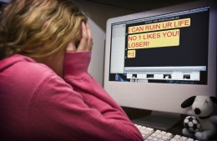
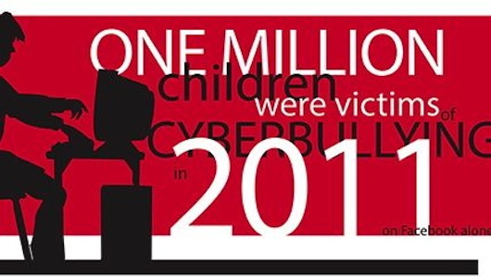
Suicide Cont.
Children and juveniles who exhibit signs of being bullied are at greater risk of being suicidal when social media is involved.
Additionally, methods of suicide are available through the same sources of social media.

Slide 22
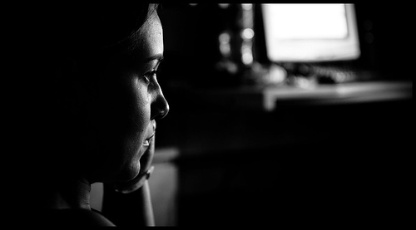
Isolation and Loneliness
“Social-networking sites like Facebook and MySpace may provide people with a false sense of connection that ultimately increases loneliness in people who feel alone. These sites should serve as a supplement, but not replacement for, face-to-face interaction,” Cacioppo says. He compares connecting on a Web site to eating celery: "It feels good immediately, but it doesn't give you the same sustenance," he says.
For people who feel satisfied and loved in their day-to-day life, social media can be a reassuring extension. For those who are already lonely, Facebook status updates are just a reminder of how much better everyone else is at making friends and having fun.” (2)

Slide 23
Health Problems Associated With Social Media
“There is an extensive range of mental and health problems known to be associated with spending too much time on social media. In addition to reducing productivity, creating distractions and increasing burnouts, they can cause some serious medical issues.” (9)

Slide 24
Health Problems Associated With Social Media Cont.
Increase Risk of Obesity- Sedentary life style, increased time spent social networking.
Eating Disorders- “Whilst the portrayal of "ideal" body types in western media has long been recognized as a factor in propagating eating disorders, current research has been examining the role of social media in the triggering and spreading of the diseases. Research has shown that eating disorders can be transmitted "like a virus" through social networks.” (12)
Mental Health Disorders- Daily overuse of social media has a negative effect on children's health making them prone to psychological disorders such as attention deficit and hyperactivity disorders, anxiety and depression.
Sleep Disorders- “Medical experts attest that school aged children are afflicted with sleep disorders because of elevated social media usage. In turn, these sleep disorders severely affect the children’s ability to maintain a healthy lifestyle and impedes their ability to perform well in school.” (11)
Addiction Disorders- See next slide

Slide 25
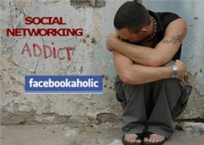
Addiction Disorder
Facebook Addiction Disorder — “When people are afraid to disconnect from social media services because they think they’re going to be missing something important. The disorder, which is not a clinical diagnosis and is not yet recognized by the broader medical community, is attracting attention. In a paper that will soon be published in the journal Psychological Science, a team of researchers from Chicago University’s Booth Business School, led by Wilhelm Hofmann, has found that Facebook and social media websites may be as addictive as alcohol or cigarettes.” (7)

Slide 26
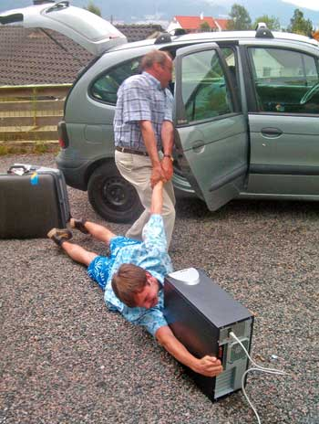
Withdrawals
In a study from the University of Maryland, students were asked to go without social media for 24 hours. The study showed students had withdrawal symptoms, “ such as anxiety, misery, and being jittery.” (6)
These symptoms are also common in people recovering from drug and alcohol addiction.

Slide 27
Final Remarks
Considering the negative effects of social media, ask yourself these questions again;
1. WHAT is this new dynamic doing to normal social interaction?
2. What impact do these social networks have on their user’s mental health?
As we embrace this new social media revolution we should be mindful of the negative effects and hazards that come along with it.

